Slide 1
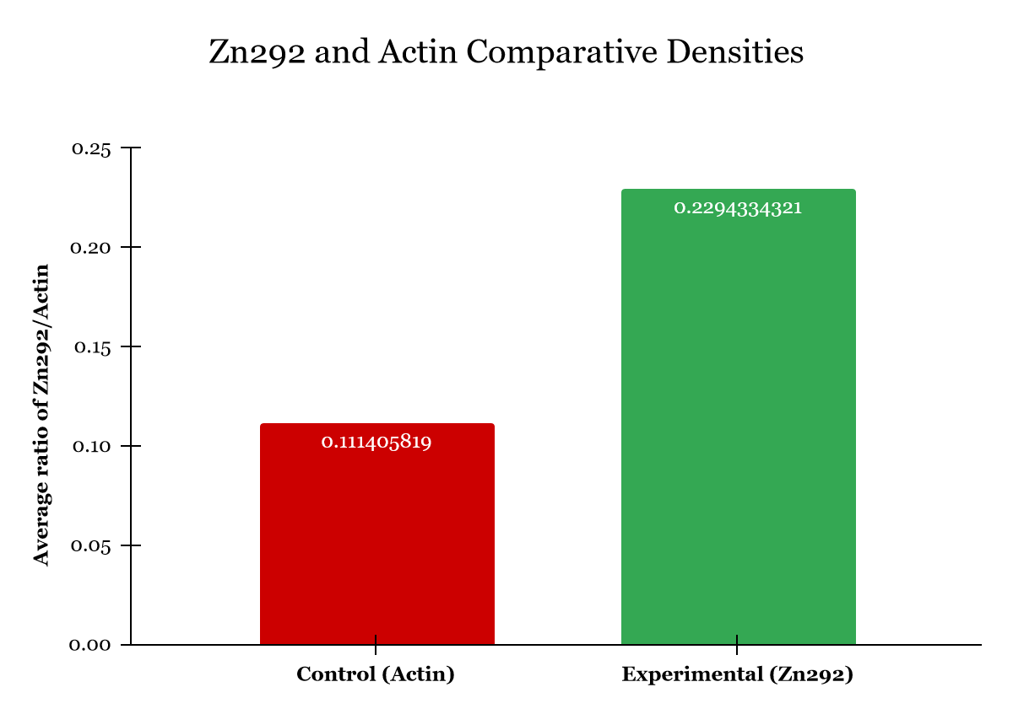
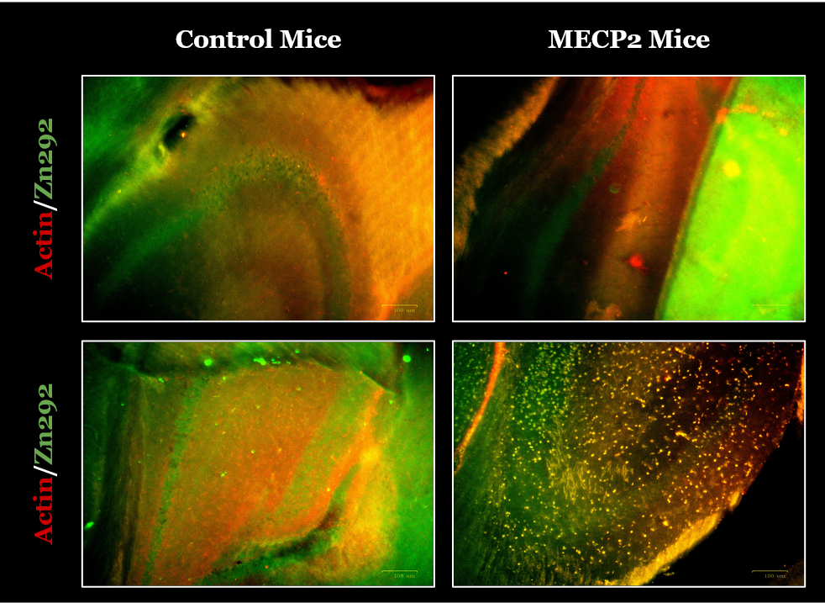
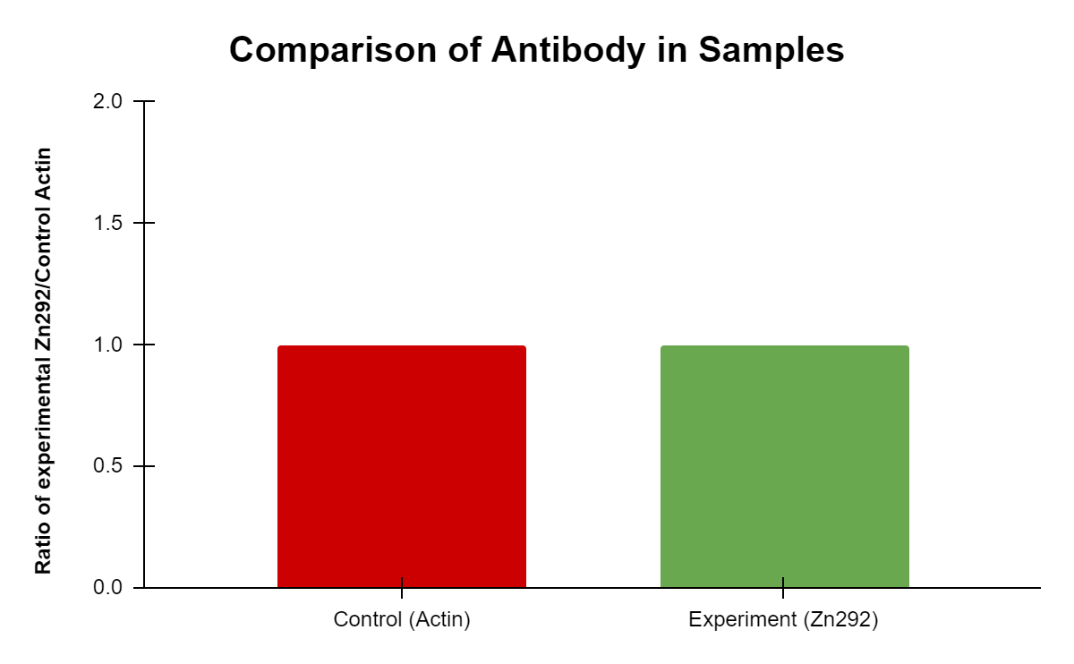
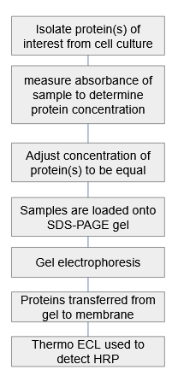
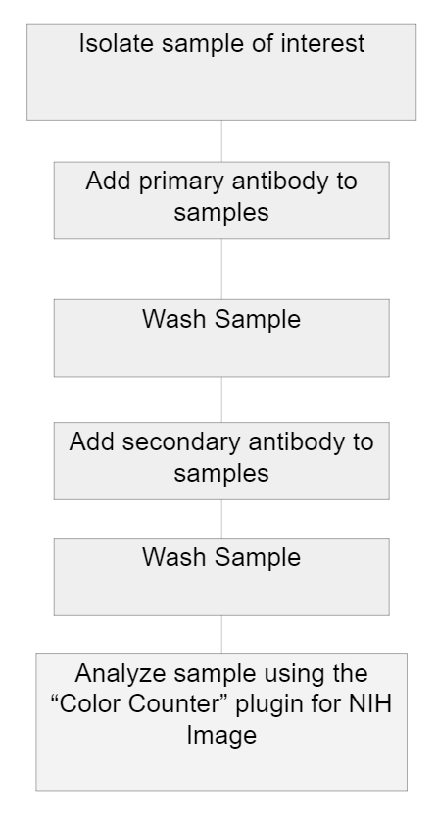
ZNF292 gene and its relation to Autism Spectrum Disorder
Carlie Charles, Lillie Franklin, & Deih Sian
Jennifer Larimore, Ph.D
Agnes Scott College, Decatur, Georgia
Abstract
Results
Discussion
In recent genome sequencing studies, a de novo mutation in ZNF292 has been linked to autism spectrum disorder (ASD). ZNF292, codes for zinc finger protein 292, and was recently discovered by Mirzaa et al. (2018). Mirzaa et al. found that ZNF292 is present in the brain during development, and that ZNF292 plays a role in transcription as well as in the regulation of voluntary movements. Few studies have been conducted to find out more about the role of ZNF292 in terms of risk of ASD. In this study, it is speculated that the de novo mutations or variants in ZNF292 are pathogenic for a spectrum of neurodevelopmental disorders such as ASD and intellectual disability (ID). Our findings suggest that there is no significant difference in the levels of ZNF292 between control mice and mice used as ASD models when ZNF292 is not mutated. We believe that further research is needed in order to better understand the impact ZNF292 mutations have on protein expression in ASD model organisms.
ZNF292
There was no significant difference found between the levels of ZNF292 and a control protein, actin, in cells of control and ASD model mice
There was no significant difference in the expression of ZNF292 in brain tissues between control and ASD model mice.
Analysis of IF data showed that there was a 1:1 ratio of ZNF292:Actin present in both control and experimental tissues
This suggests that the level of ZNF292 in ASD mouse brain tissue is clinically normal
When analyzing the relative densities of ZNF292 and Actin, an unpaired t-test produced a p-value of p=0.0823 rendering any difference in the data as insignificant
Further testing with a larger sample size could shed light on any differences that may exist in relative protein expression between the two mouse models
A
B
Actin
C
Introduction
Figure 1. Western blot analysis of ZNF292 (A) and Actin control (B) protein density. (C) depicts the average ratio of the control to the experimental density. An unpaired t-test determined the p-value to be p=0.0823 which does not meet the criteria for statistical significance.
Conclusion
The ZNF292 gene encodes zinc finger protein 292, a transcription factor that is growth hormone-dependent in order to function. ZNF292 is expressed in the cerebellum, which is part of the central nervous system that controls motor functions and is associated with cognition. There is a lack of knowledge in the direct function of ZNF292 during neurodevelopment, and which variants of ZNF292 could disrupt synaptic transmission during brain development. In 2018, Guo’s research team further established ZNF292 variants as a novel ASD risk gene, and a recent research study led by Mirzaa, showed that patients with ZNF292 mutations exhibit features of neurodevelopmental disorders. The hypothesis of this study is that ZNF292 variants are pathogenic for a spectrum of neurodevelopmental disorders.
This study was conducted to determine the relationship between de novo ZNF292 mutations and its role as a risk factor for ASD and intellectual disability (ID).
Findings from experimentation on mice models suggest that there was no significant difference of protein density of ZNF292 compared to the control protein Actin
All p-values obtained were p>0.05 and therefore insignificant
From these results, we cannot make any conclusions that there are any clinical differences in ZNF292 expression in ASD mice compared to control mice
A
KO Mice
Further Research
There is further research needed to examine the effects of de novo ZNF292 mutations on ASD, specifically the effects that these mutations have on ZNF292 expression, in order to better understand if ZNF292 variants could increase the severity of ASD. It is also important to further investigate the relationship between ZNF292 variants and up/down regulation of other genes known to be implicated in ASD. While it does not seem that ZNF292 levels vary between control and ASD model mice when ZNF292 is not mutated, it is very possible that variants could increase the risk of developing ASD or ASD severity.
Methods
B
Western Blot Procedure
Immunofluorescence Procedure
Figure 2. (A) Immunofluorescence (IF) staining of dentate gyrus highlighting ZNF292 and Actin levels in control mice and ASD model mice. (B) Bar graph showing the 1:1 ratio of control to experimental samples. A t-test was not performed because the data was already known to be insignificant.
Acknowledgements
We would like to thank Dr. Larimore for her help in performing the experiments described, and for her advice throughout this research project.

