Slide 1
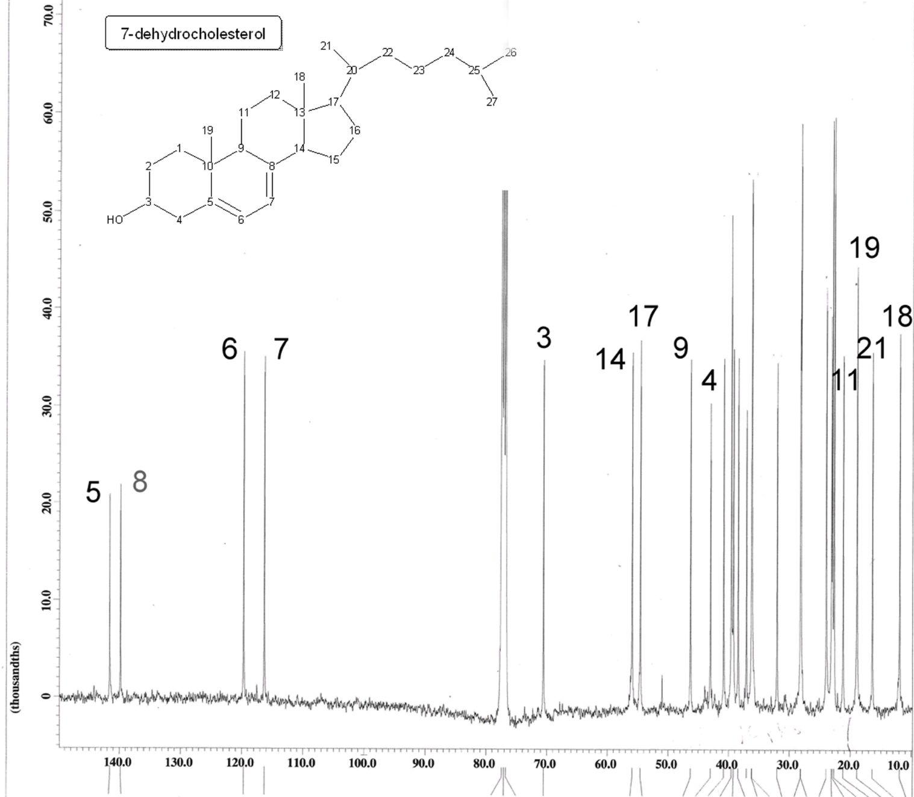
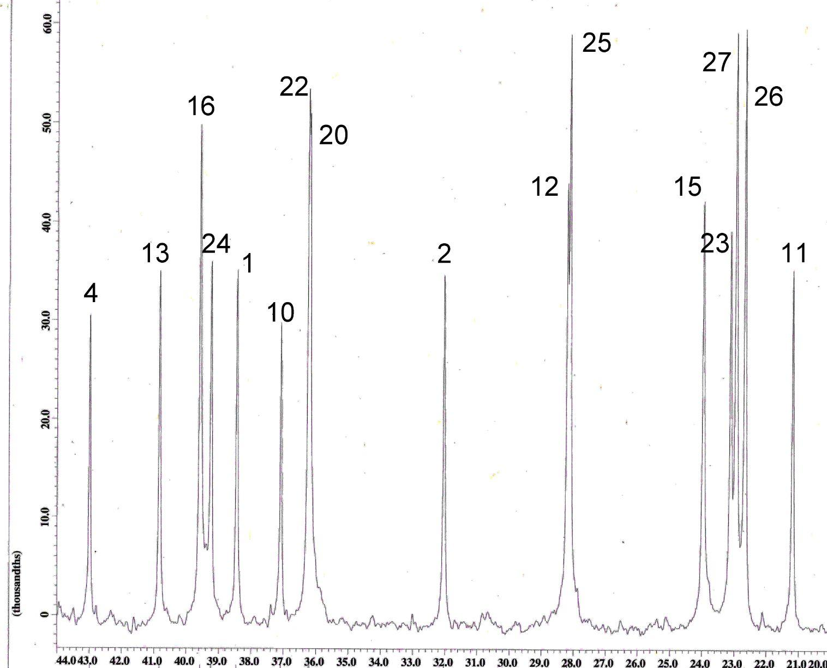
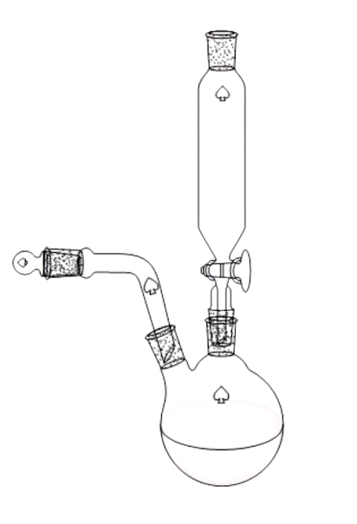
Synthesis of (7-Dehydrocholesterol)RuCl₂]₂
Narmeen Babar, Kayla Melton, Deih Sian,T. Leon Venable
Department of Chemistry, Agnes Scott College, Decatur, GA
Introduction
Results
Discussion
Most modern medicines on the market, when taken, flow throughout the entire body. If a site specific ring can be added to a pharmaceutical it could open up a wide range of opportunities in the field of medicine. Boron neutron capture therapy (BNCT) is a technique currently being used to treat skin cancer and certain melanomas. The overall molecule consists of three main components: the ruthenium-ligand allows the molecule to be site or tissue specific when absorbed; the ruthenium is being used as a linking group within the molecule and can be used in pharmaceuticals due to its low toxicity levels; and the boron cluster allows BNCT use.
¹³C NMR spectroscopy was used to analyze the difference between the starting materials, 7-dehydrocholesterol and the product, [(7-dehydrocholesterol)RuCl₂]₂.
The analysis of the ¹³C NMR spectra showed a significant difference between the starting material and the product due to different chemical shifts and the number of carbon peaks.
¹H NMR showed a decrease in number of hydrogen atoms attached to the steroid in the product. This further suggests that the ruthenium successfully attached to the steroid with the double bonds of the aromatic ring.
A
Objective
Conclusion
The objective of this research was to synthesize a variety of different types of ruthenacarboranes that could be possible for specific binding target molecule.
Figure 2. (A) Molecular structure and ¹³C NMR spectrum of 7-Dehydrocholesterol.
This study was conducted to prepare and characterize [(7-dehydrocholesterol)RuCl₂]₂ by combining commercially available reagents, 7-dehydrocholesterol, and RuCl₃ in THF. Step 2 would be used to attach carborane for the potential use as a BNCT.
Findings from the NMR spectra suggest that the ruthenium is successfully attached to the arena ring; however, this is an intermediate result. From these results, we were unable to make any conclusions that [(7-dehydrocholesterol)RuCl₂]₂ can be used as a potential BNCT agent. In order for it to be used as a potential BNCT agent, the product needs to have a carborane that contains boron nuclei which are necessary for BNCT.
B
Methods
A
RuCl₃x H₂O
+
C₂₇H₄₄O
Characterization: IR, ¹³C NMR spectroscopy
In THF
Further Research
(Fig. 1)
Figure 2. (B) Zoomed ¹³C NMR spectrum of 7-Dehydrocholesterol.
Further work includes performing ¹H NMR spectroscopy to further characterize the product.
Future work should also include attaching the carborane to the (7-dehydrocholesterol)RuCl₂]_{2.}
The attachment of the carbornane will allow us to explore the use in boron neutron capture therapy.
((C₂₇H₄₄O)RuCl₂)₂
Acknowledgements
We would like to thank Dr. Venable for the opportunity to help in his project and for his mentorship. This research has been funded by the generosity of The Frances Marx Shillinglaw Women in Science Endowed Fund, The Maria Wornom Rippe ’64 STEM Research Expendable Fund, The Arthur T. Allen, Jr., Ph. D. and Arthur T. Allen III, M.D. Science Fund, and The Sherman Fairchild Foundation Summer Stipend Program.
Fig.1 Apparatus for the synthesis of [(7-Dehydrocholesterol)]RuCl₂]₂
Dimer
Figure 3. ¹³C NMR spectrum of proposed [(7-Dehydrocholesterol)RuCl₂]₂.

